Slide 1

Efficient Traceable Authorized Search System For Secure Cloud Storage
Department Of CSE
M. Karthik 192P1A0569
M. Mahaboob Basha 192P1A0576
P. Bindu Shruthika 192P1A0596
P. Naga Lakshmi 192P1A0595
M.Mahendra Kumar Reddy 192P1A0575
Project Guide Project Co-ordinator Head Of Department
Mr. N. Srinivasan Mr. N. Srinivasan Mrs. D. Salma Faroze

Slide 2
Contents
Abstract
Introduction
System requirements
Hardware requirements
Software requirements
Modules Used
UML Diagrams
Use Case Diagrams
Class Diagrams
Sequence Diagrams
Activity Diagrams
Screenshots of Results
Test Cases
Conclusion
References & Web Resources

Slide 3
Abstract
Secure search over encrypted remote data is crucial in cloud computing to guarantee the data privacy and usability. To prevent unauthorized data usage, fine-grained access control is necessary in multi-user system.
However, authorized user may intentionally leak the secret key for financial benefit. Thus, tracing and revoking the malicious user who abuses secret key needs to be solved imminently.
We propose an escrow free traceable attribute based multiple keywords subset search system with verifiable outsourced decryption.
Also, the decryption process only requires ultra lightweight computation, which is a desirable feature for energy-limited devices. In addition, efficient user revocation is enabled after the malicious user is figured out.
Moreover, the proposed system is able to support flexible number of attributes rather than polynomial bounded. Flexible multiple keyword subset search pattern is realized, and the change of the query keywords order does not affect the search result.

Slide 4
Introduction
Network Model : The system comprises of four entities, namely
Key Generation Center ( KGC )
Cloud Server ( CS )
Data Owner
Data User
Generate Secure File And Keyword Model : In this Model Data Owner extracts a keyword set from the file. Then encrypts the message with secret key using Cryptographic secure symmetric encryption algorithm and generates a verification key that can be used to verify the result of outsourced computing..
File Recovery and Verification Model: The verification key is generated in the Encryption algorithm, which is used to verify the correctness of the transformed cipher text that is generated by the cloud server in the following Test & Transform algorithm. The encrypted files, secure keyword set indexes and verification keys are outsourced to cloud storage.
Trace Malicious User Model: If an authorized use publicly sells or leaks his attribute secret key, then the misbehavior will be discovered. Then the key sanity check algorithm verifies the sanity of the key and the trace algorithm recovers the traitors real identity.

Slide 5
System Requirements
Hardware requirements:
Processor : i3 or above
RAM : 2 GB or more
Hard disk : 40 GB or more
Software requirements:
Operating system : windows 10 or above
Coding language : java/J2EE
Tool : netbeans 7.2.1 or above
Database : mysql

Slide 6
Modules Used
Data Owner
Data User
Key Generation Centre(KGC)
Cloud Secure (CS)

Slide 7
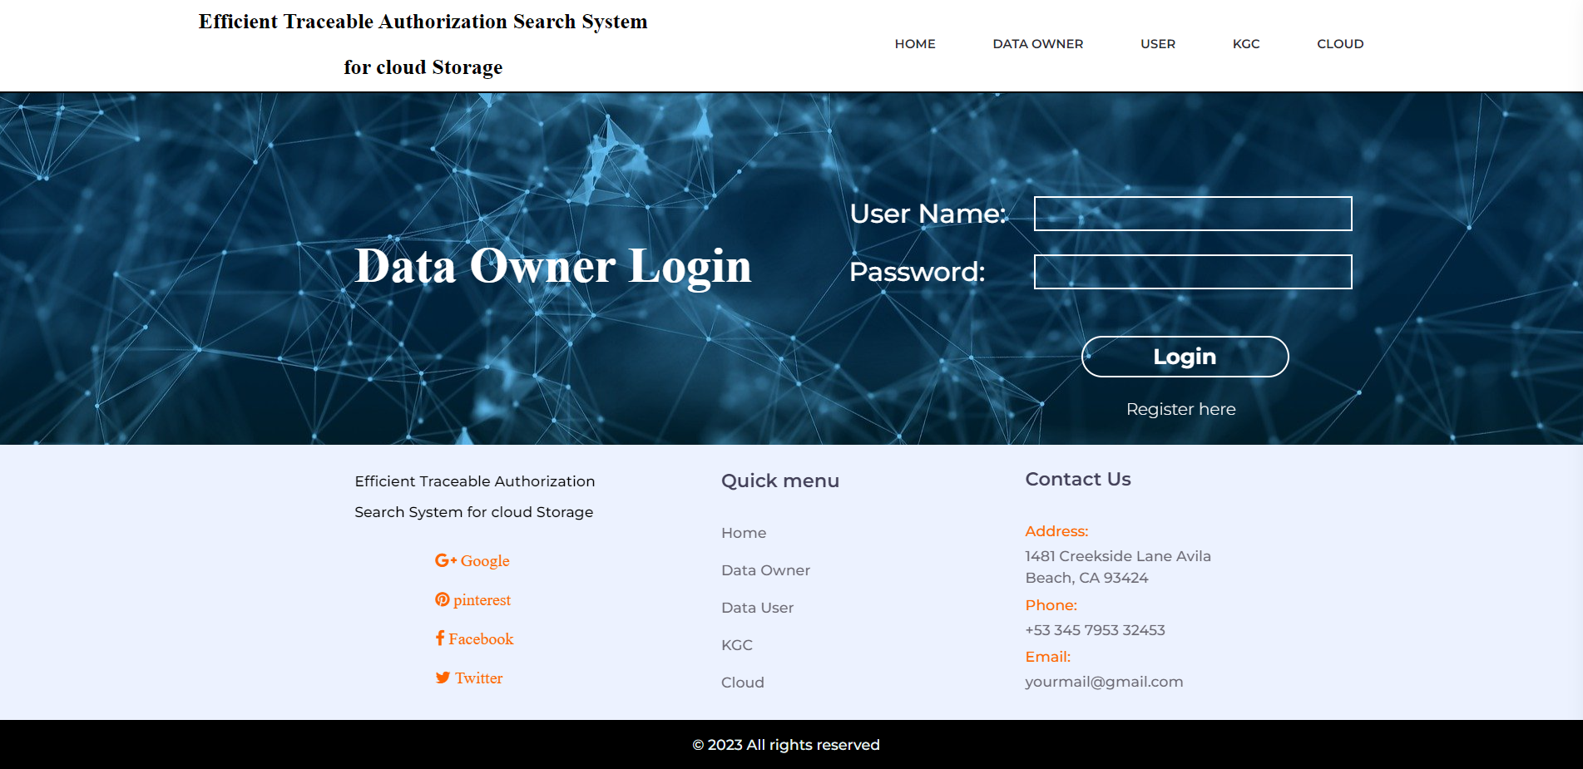
Module – 1 : Data Owner
Module – 1 : Data Owner
Data owner utilizes the cloud storage service to store the files.
Before the data outsourcing, the data owner extracts keyword set from the file and encrypts it into secure index.
The document is also encrypted to ciphertext.
During the encryption process, the access policy is specified and embedded into the ciphertext to realize fine-grained access control.

Slide 8
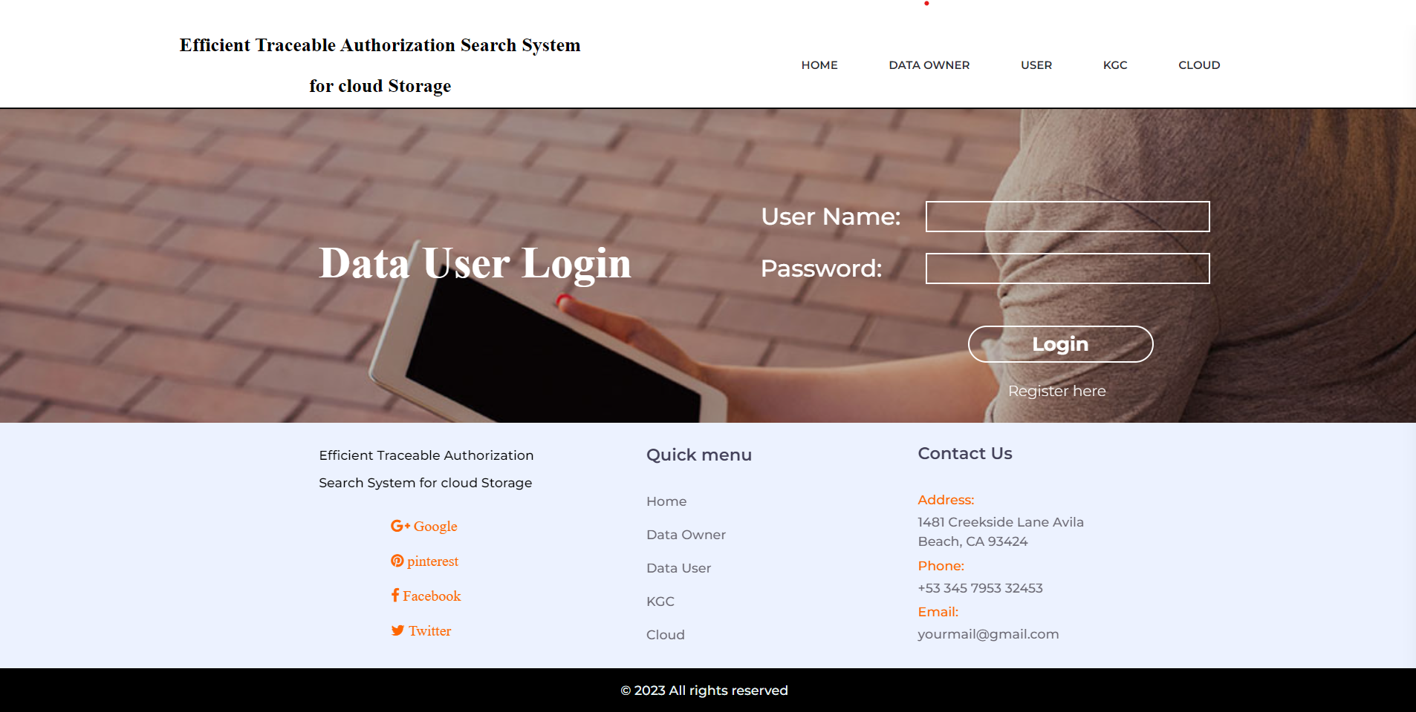
Module – 2 : Data User
Each data user has attribute set to describe his characteristics, such as professor, computer science college, dean, etc.
The attribute set is embedded into user’s secret key. Using the secret key, data user is able to search on the encrypted files stored in the cloud, i.e., chooses a keyword set that he wants to search.
Then, the keyword is encrypted to a trapdoor using user’s secret key. If the user’s attribute set satisfies the access policy defined in the encrypted files, the cloud server responds on user’s search query and finds the match files.
Otherwise, the search query is rejected. After the match files are returned, the user runs decryption algorithm to recover the plaintext.

Slide 9
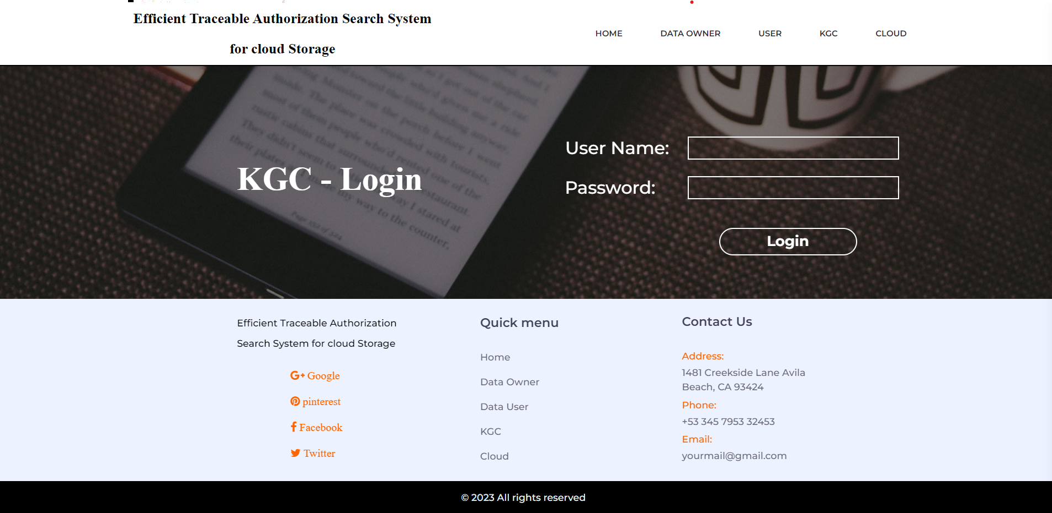
Module – 3 : Key Generation Centre
KGC is responsible to generate the public parameter for the system and the public/secret key pairs for the users.
Once the user’s secret key is leaked for profits or other purposes, KGC runs trace algorithm to find the malicious user.
Once After the traitor is traced, KGC sends user revocation request to cloud server to revoke the user’s search privilege.

Slide 10
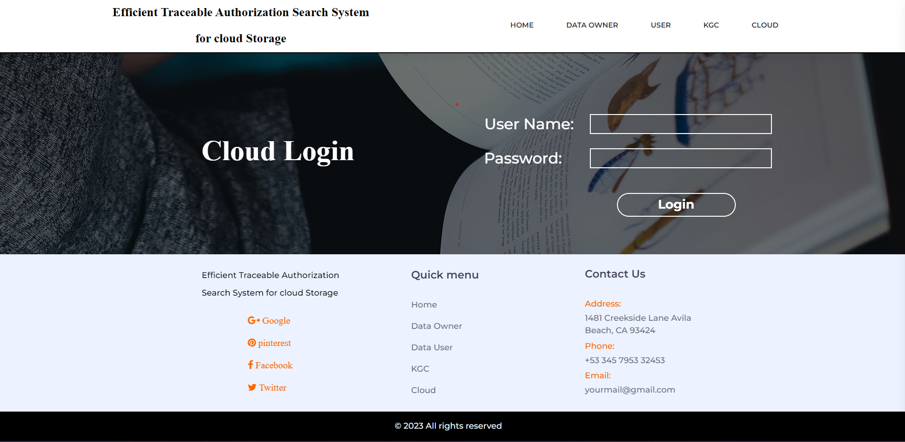
Module – 4 : Cloud Server
Cloud server has tremendous storage space and powerful computing capability, which provides on-demand service to the system.
Cloud server is responsible to store the data owner’s encrypted files and respond on data user’s search query.

Slide 11
UML Diagrams
Use Case Diagrams
Class Diagrams
Sequence Diagrams
Activity Diagrams

Slide 12
Use Case Diagrams
register
register
Activate owner
view owner files
file upload
data owner
Search file
Activate user
data user
Secret key , public key
view files
KGC
Request for file
Owners Details
File details
Send Key
otp
Cloud
Users Details
download
,
View Files

Slide 13

Class Diagrams
Class Diagrams

Slide 14
Sequence Diagrams

Slide 15
Activity Diagrams
DataOwner
DataUser
KGC
Cloud
Upload
FileSearch
Activate User
view owner details
ViewFile
secretkey,publickey
view user details
Activate Owner
Otp
viewfiles
Download

Slide 16
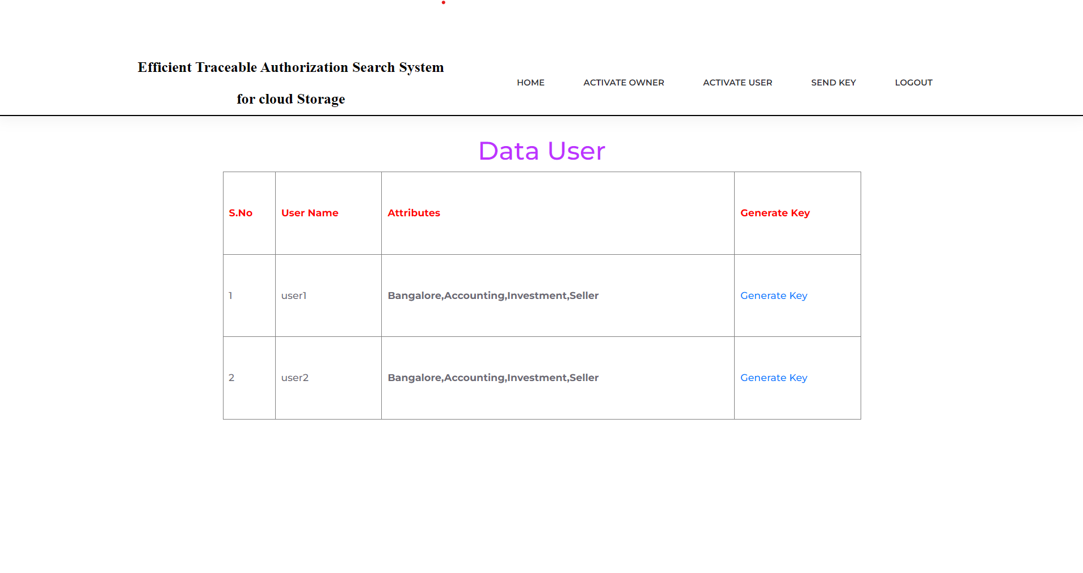
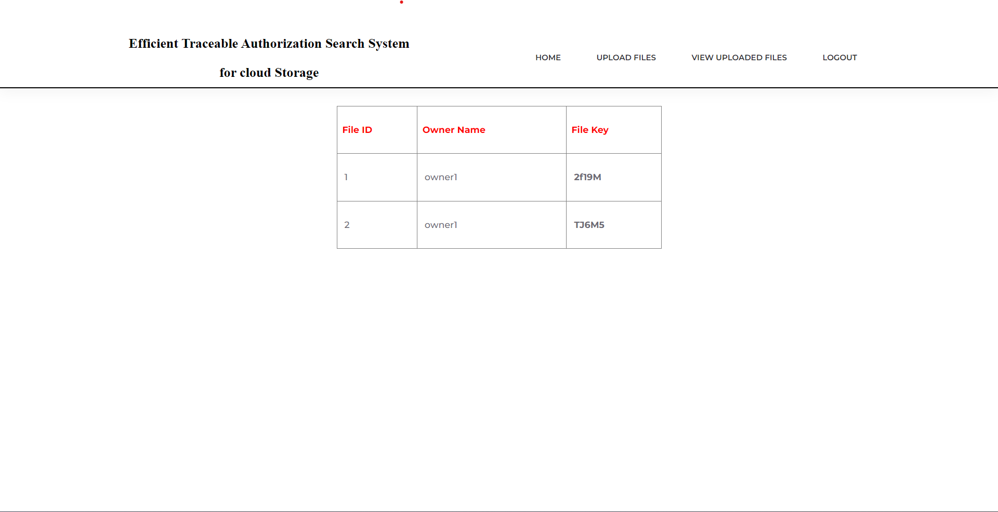
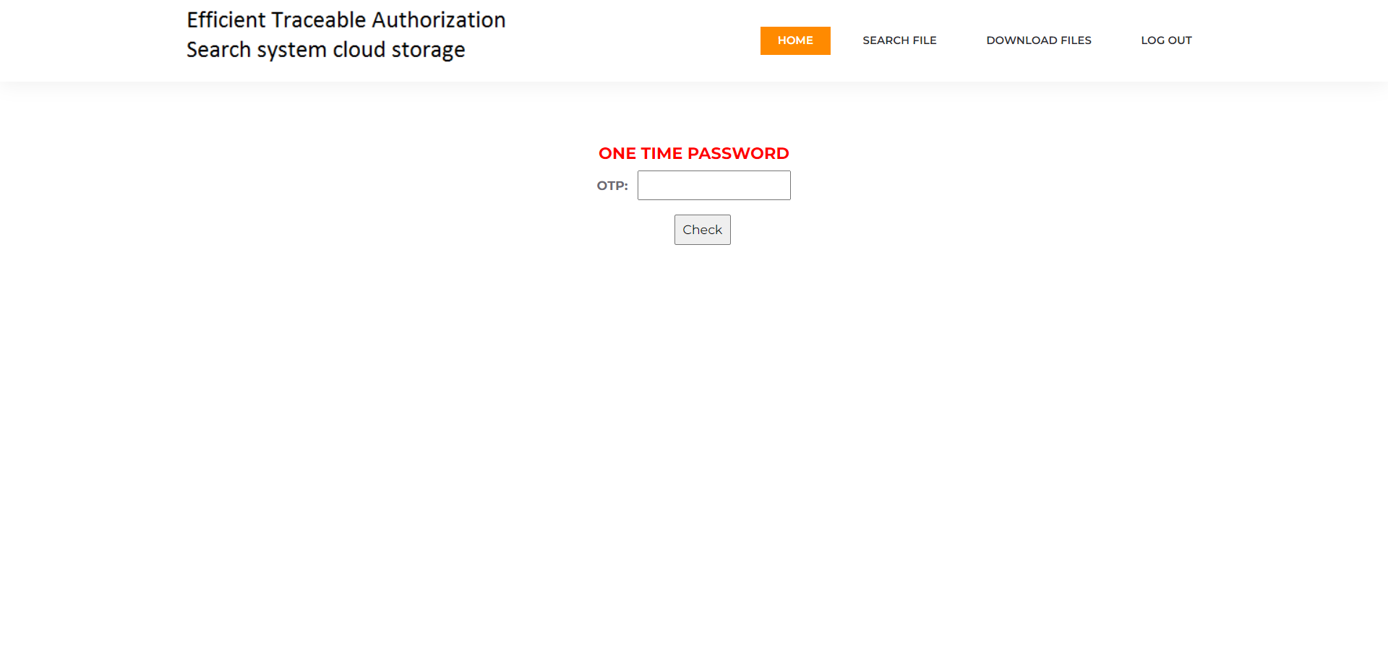
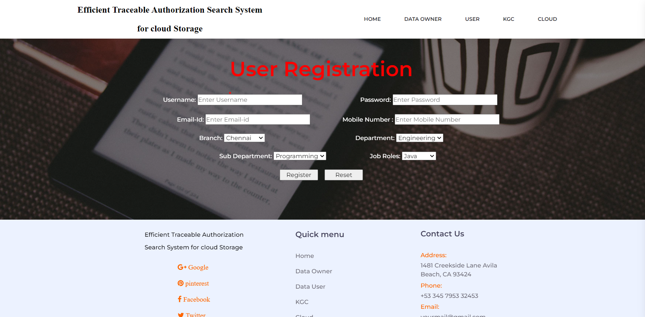
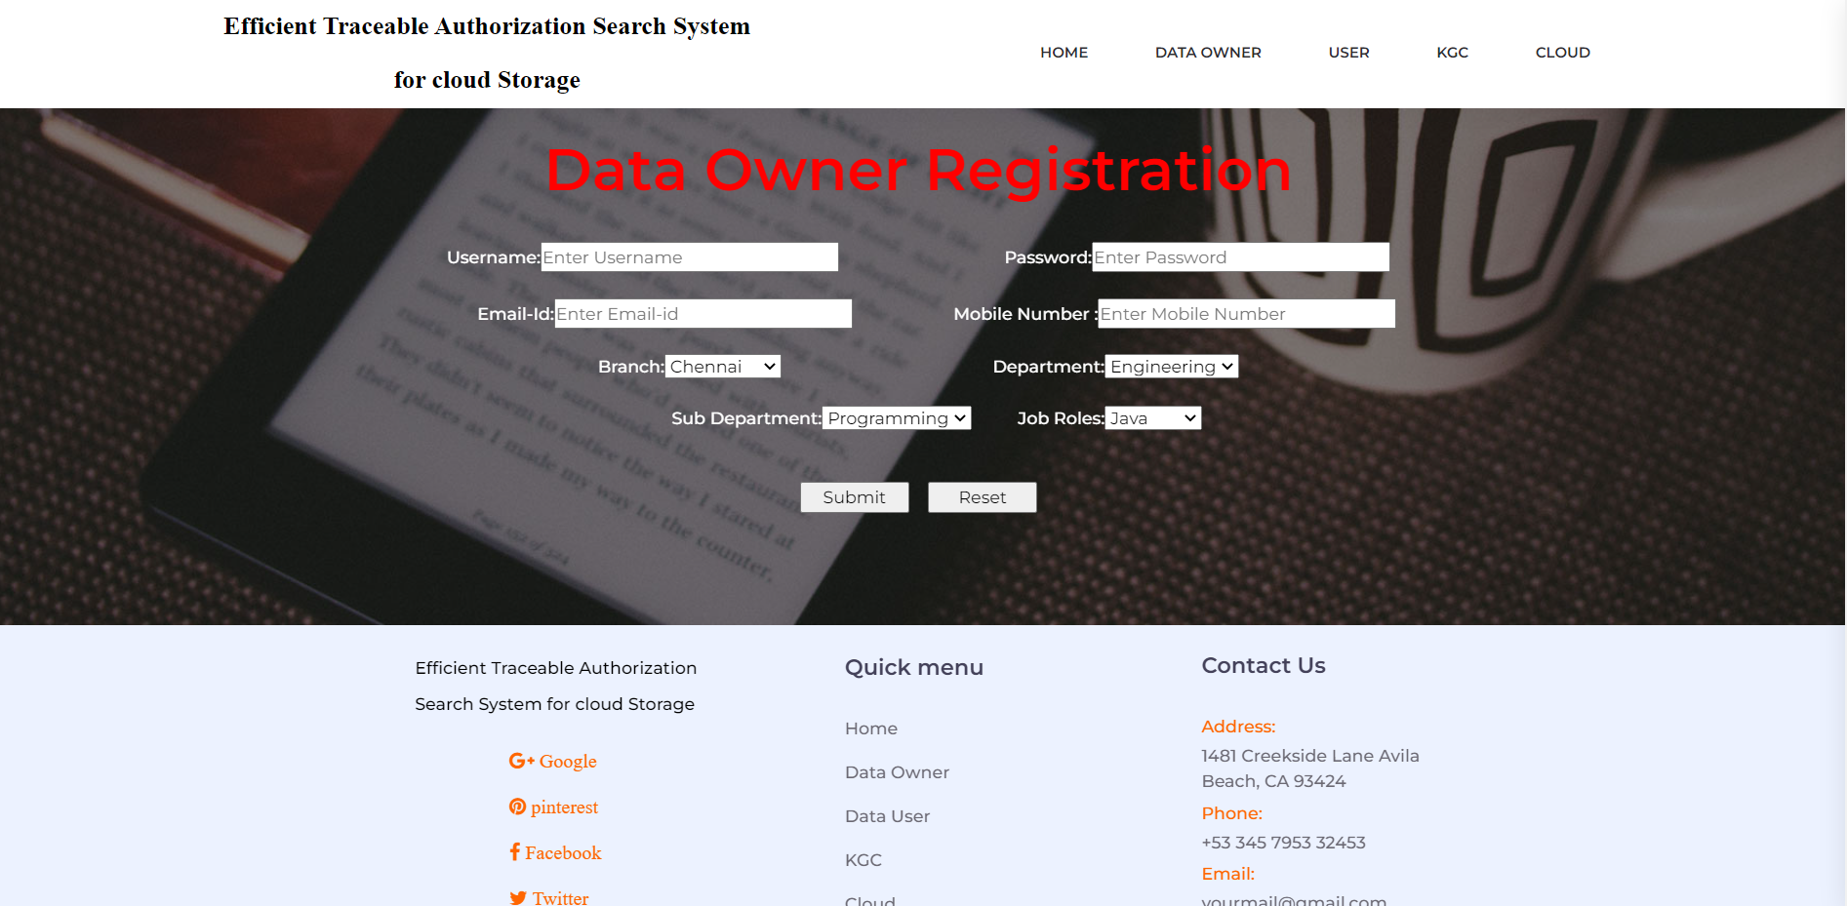
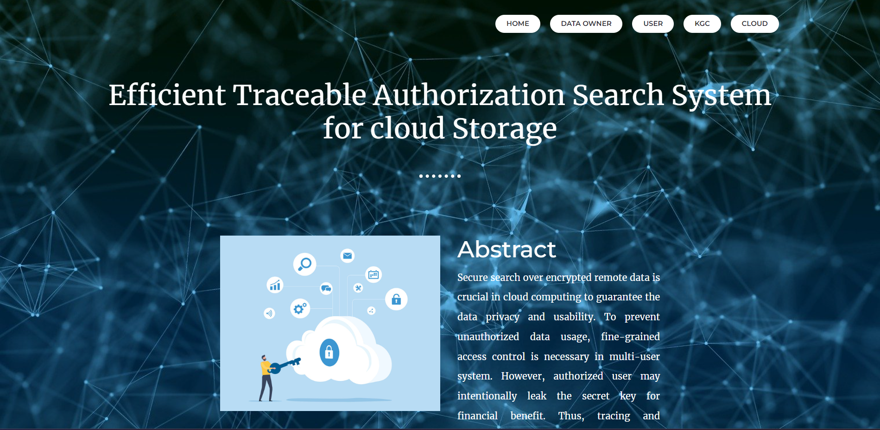
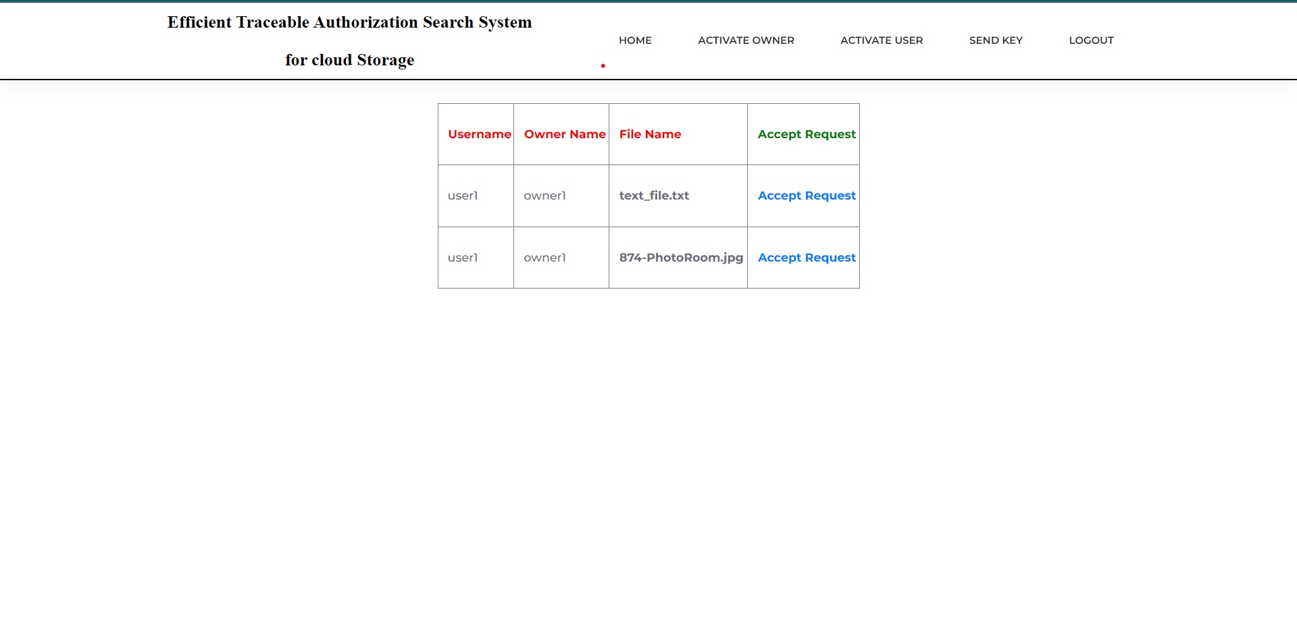
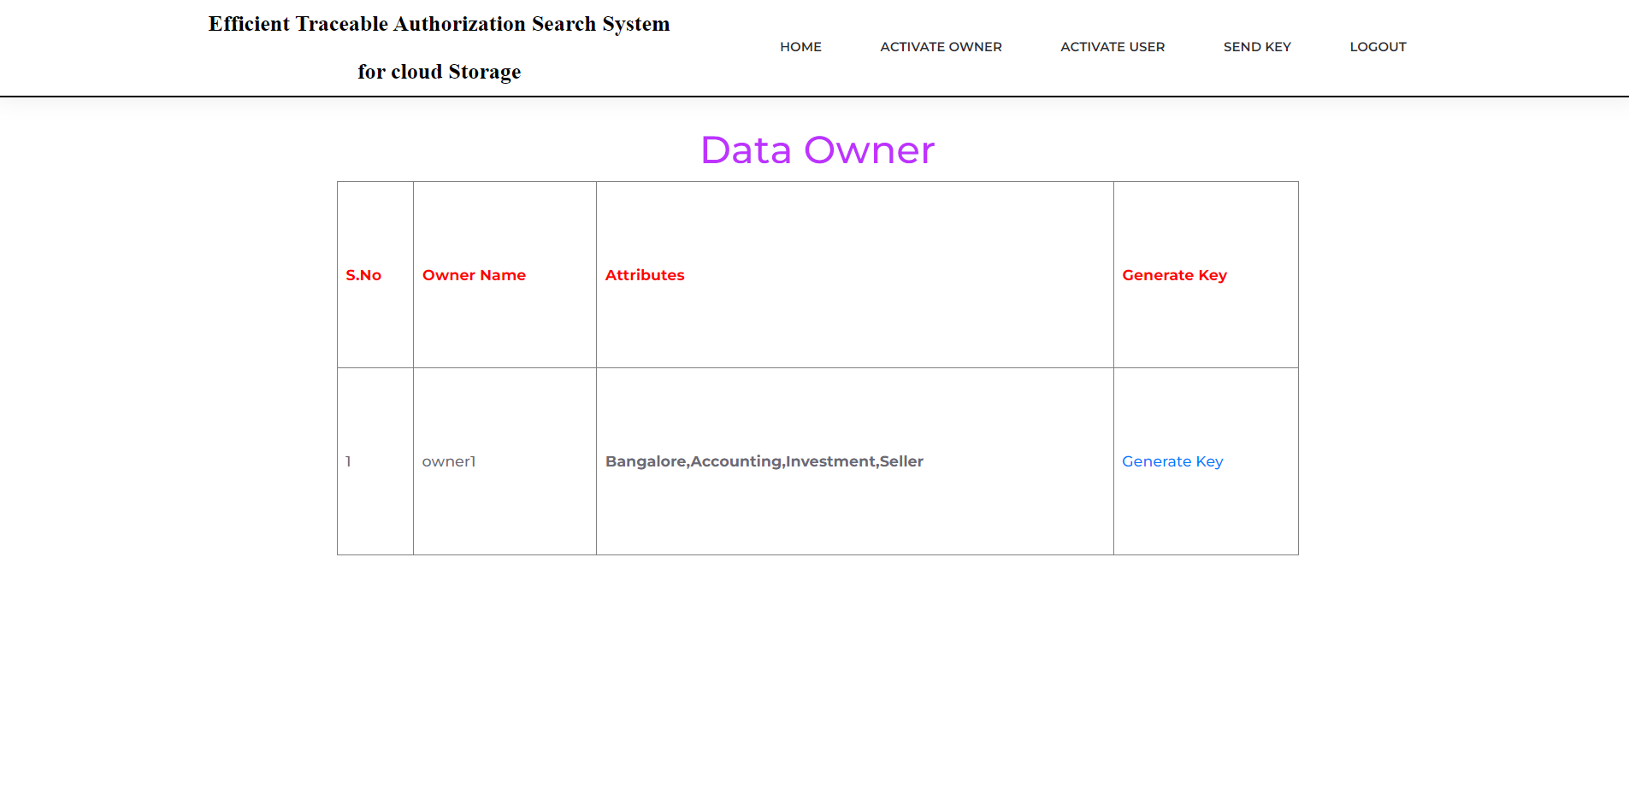
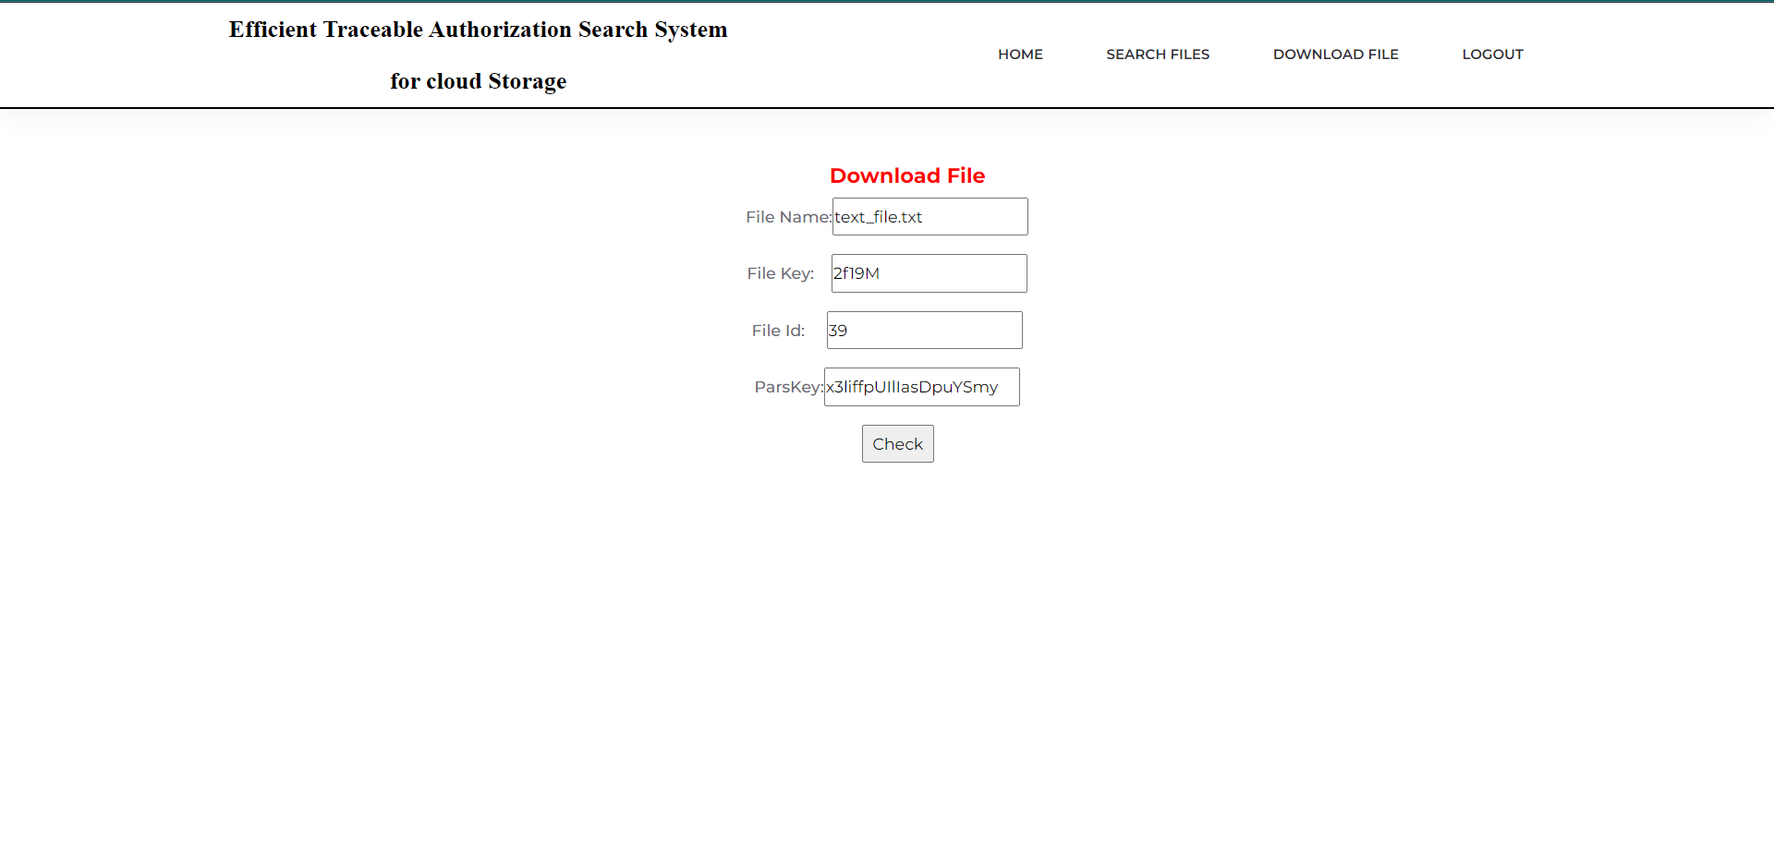
Screenshots of Results

Slide 17
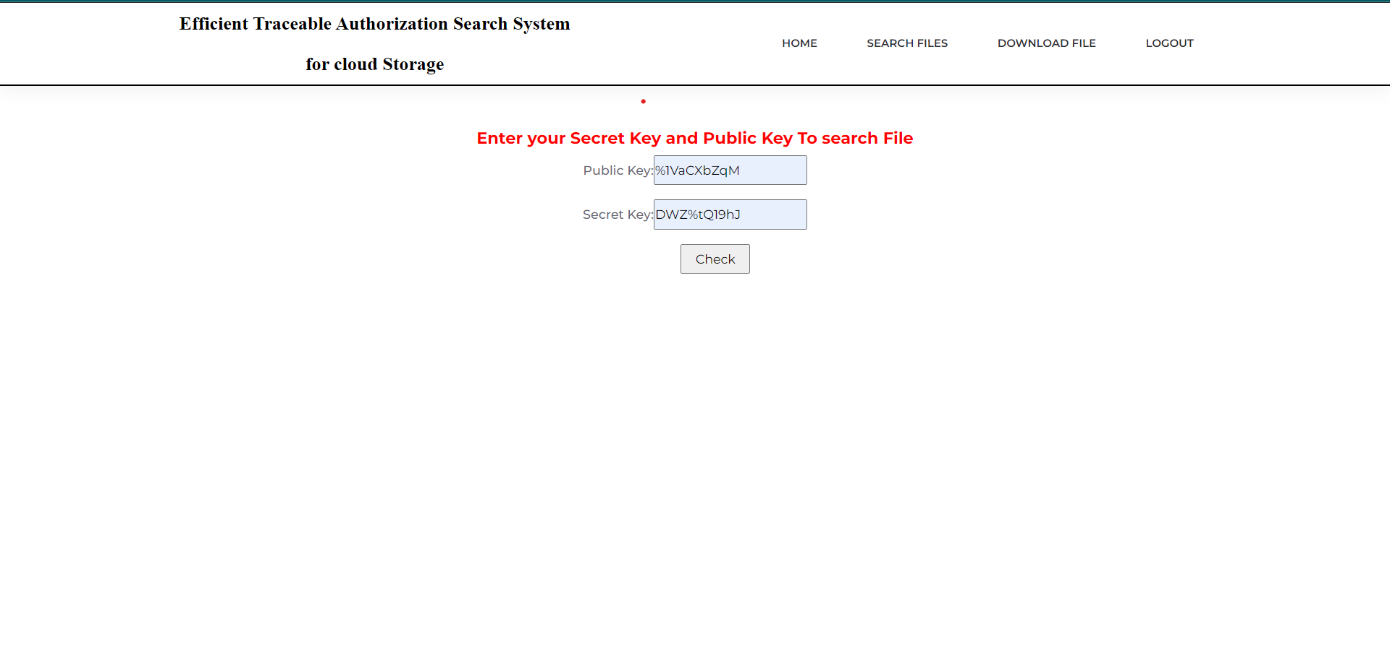
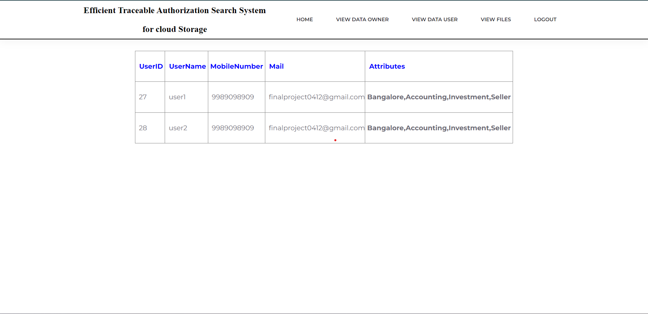
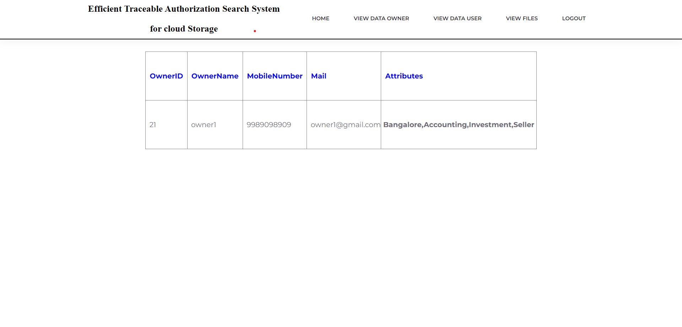
Test Cases

Slide 18
Conclusion
The enforcement of access control and the support of keyword search are important issues in secure cloud storage system. So in our project, we defined a new paradigm of searchable encryption system, and proposed a concrete construction.
The process involves the registration of both users and data owners, and the matching of their attributes or keywords to ensure that they are linked correctly. Once registered, both users and data owners need to be accepted by the KGC (Key Generation Center) and provided with public and private keys to access the cloud server.
Users can then search for files uploaded by the data owner and request details from KGC, who will check their authenticity and provide file details if verified. To access the file, KGC generates an OTP (One Time Password) that the user must enter correctly before being allowed to download the requested file from the cloud server. This process helps ensure the security and integrity of the data stored on the cloud server and restricts access to authorized users only.

Slide 19
References
C. Wang, N. Cao, J. Li, K. Ren, W. Lou. "Secure ranked keyword search over encrypted cloud data"[c]//IEEE 30th international conference on distributed computing systems (ICDCS), IEEE, 2010: 253-262.
Q. Zhang, L. T. Yang, Z. Chen, P. Li, M. J. Deen. “Privacy-preserving double-projection deep computation model with crowd sourcing on cloud for big data feature learning,” IEEE internet of things journal, 2017, DOI: 10.1109/jiot.2017.2732735.
R. Chen, Y. Mu, G. Yang, F. Guo and X. Wang, “dual-server public- key encryption with keyword search for secure cloud storage,” IEEE transactions on information forensics and security, 2016, vol.11, no. 4, 789-798.
R. Liu, R.H. Deng, K.K.R. Choo, J. Weng. ”An efficient privacy preserving outsourced calculation toolkit with multiple keys.” IEEE transactions on information forensics and security 11.11 (2016): 2401-2414.
Web Resources
https://jpinfotech.org/efficient-traceable-authorization-search-system-for-securecloud-storage/
http://ieeexplore.ieee.org/document/8327889/
http://inpressco.com/secure-and-efficient-traceable-authorization-multi-keywordsearch-system-for-cloud-storage-using-blockchain-technology/

Slide 20
Thank You

